Slide 1
VOLUME CONTROL USING HAND GESTURE AND FINGER COUNTER IN HAND
Exploratory Project
Semester-IV 2020-21
1909
Mentored By:-
Prof. Vishwambhar Nath Mishra

Slide 2
Aim and Objectives
The project aims to create interaction between machine hardware and hand gestures using landmarks on hand to minimise the use of hardware.
So our objective is to create some applications of this through which we can illustrate the use of our project.
This project includes:-
Volume controller using hand movement.
Counter using hand landmarks of fingers.

Slide 3
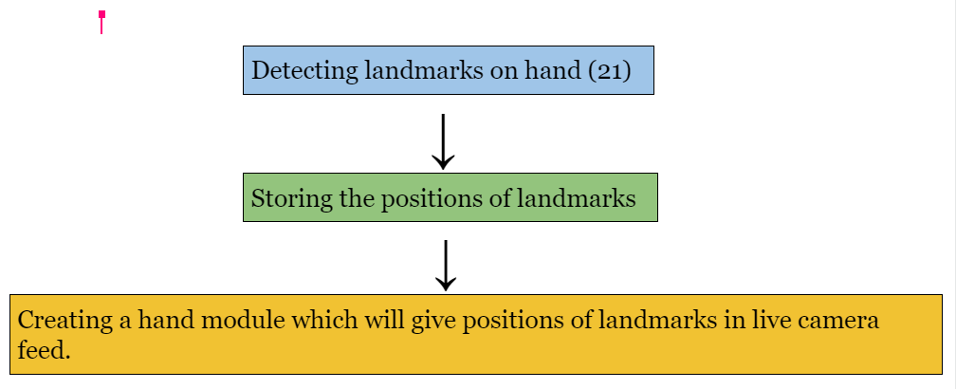
OVERVIEW
Workflow to make hand module .

Slide 4
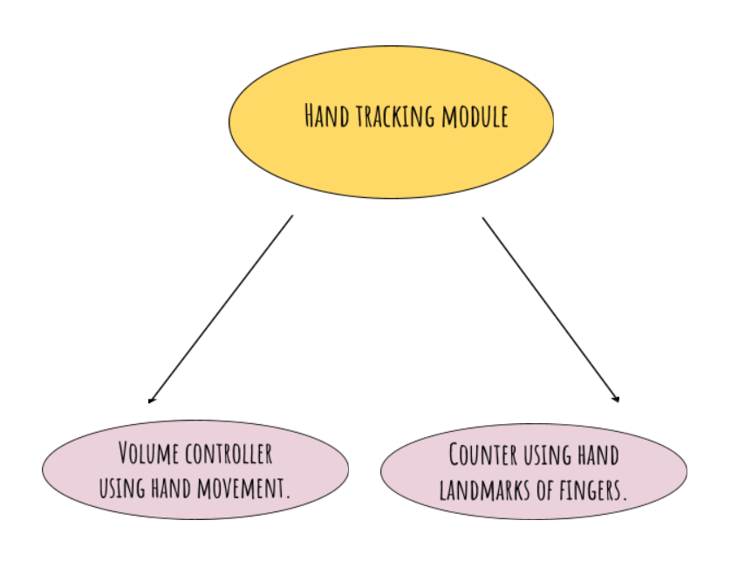
We used hand module
To make volume controller and counter

Slide 5
Hand Module
The work of hand module is divided into two parts :
Palm detection model: It basically detect hand from feed and detects 21 points on palm as shown in below figure.
Hand tracking model : It finds coordinates of those 21 points on the detected palm with their corresponding ID’s.

Slide 6

ID corresponding to top of index finger is 8
This chart shows relation of points with respect to ID’s

Slide 7
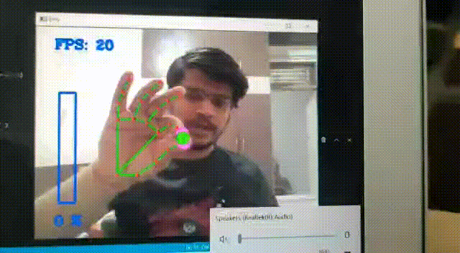
Volume Controller using Hand Movement
Here we can see that changing the distance between index finger and thumb increases and decreases volume correspondingly.
Here we can see computer volume being changed.

Slide 8
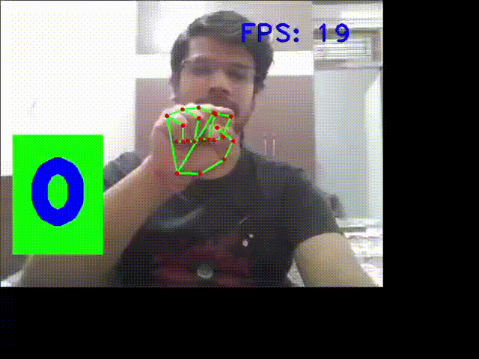
Counter using Hand Landmark of Finger
Using relative positions of 21 points this counter counts number of finger we are showing to camera.
Here we show our output calculated

Slide 9
Conclusion and future
We can conclude that our exploration on this project can be good be use in various fields in daily life. This will reduce the human dependency on hardware.
In this time of pandemic we are avoiding touch to any surface. By our project we can make smart control systems which minimizes human touch. This have tremendous future use like - smart homes, high security systems etc.

Slide 10
Project By:-
Abhinandan Agarwal (19095001)
Abhineet Anand(19095002)
Abhishek Maurya(19095003)
Aditya Agarwal(19095004)
Thank You

